Slide 1
Programming Fundamentals
By
Shazmeen Batool

Slide 2
Lab Task 1
You have a variable storing a student's age. Use a pointer to access and print the age, then change the age through the pointer and print it again.

Slide 3
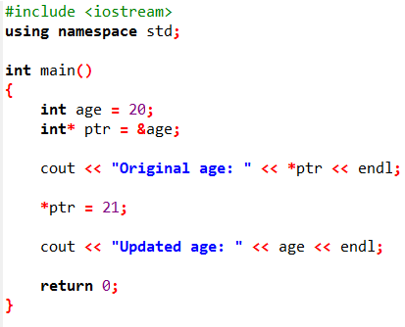


Slide 4
Lab Task 2
You have an array of 5 test scores. Use a pointer to iterate through the array and print each score, then calculate and print the sum.

Slide 5
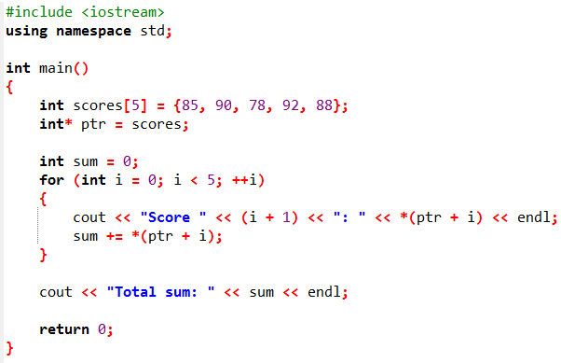
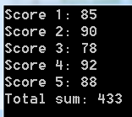

Slide 6
Lab Task 3
What is the output of the program in the next slide?

Slide 7
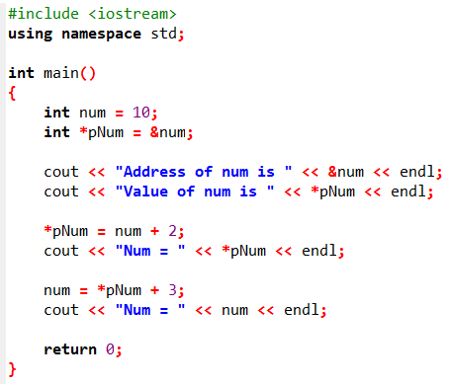


Slide 8
Lab Task 4
What is the output of the program in the next slide?

Slide 9
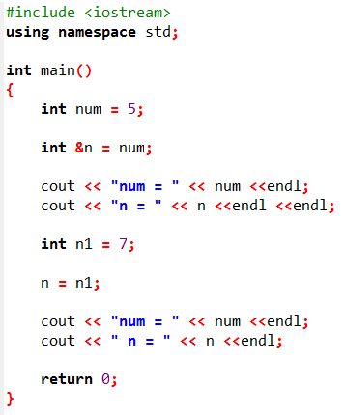


Slide 10
Lab Task 5
What is the output of the program in the next slide?

Slide 11
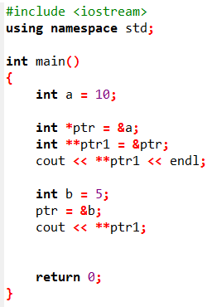


Slide 12
Lab Task 6
What is the output of the program in the next slide?

Slide 13
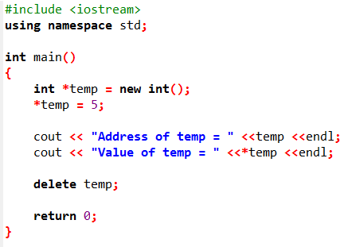


Slide 14
Lab Task 7
Write a C++ program that prompts the user to enter an integer value, then uses a pointer to access and display that value.

Slide 15
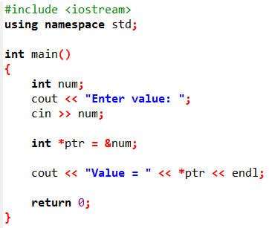


Slide 16
Lab Task 8
You are entering marks for a certain number of students in a class. Write a program that:
Prompts the user to enter the number of students.
Uses dynamic memory allocation to create an array for their marks.
Uses a pointer to input marks for each student.
Displays all the marks using the pointer.
Frees the allocated memory.

Slide 17
